Slide 1
QEMT
Quantum Entangled Multiplexing Transceiver
A Proposed Architecture for Faster-Than-Light Signalling
via Entangled Particle Slabs, Orientation Encoding, and Ensemble Weak Measurement
Daniel Miles · 2026 · Original Concept Paper — Draft for Discussion

Slide 2
Overview
Entangled particle slabs
Full-duplex transceiver
Two slabs manufactured as one unit, cleaved apart. Position correspondence guaranteed by geometry — no calibration needed.
One slab per machine, split TX / RX. Top rows transmit, bottom rows receive simultaneously.
Virtual disc encoding
Miniature coil write
Software lookup table maps orientation angles to characters. HOME (0°) permanently reserved as message delimiter.
Each photon cavity has its own nanoscale coil. MCU-driven magnetic pulse sets orientation in nanoseconds.
Ensemble weak measurement
Three transmission modes
All N particles per row set to the same orientation. Receiver averages N weak reads — noise reduces by √N.
Max signal (all rows, same char) · Parallel message (one char per row) · Cascading pipeline (rolling advance).
Quantum Entangled Multiplexing Transceiver (QEMT) | Daniel Miles · 2026

Slide 3
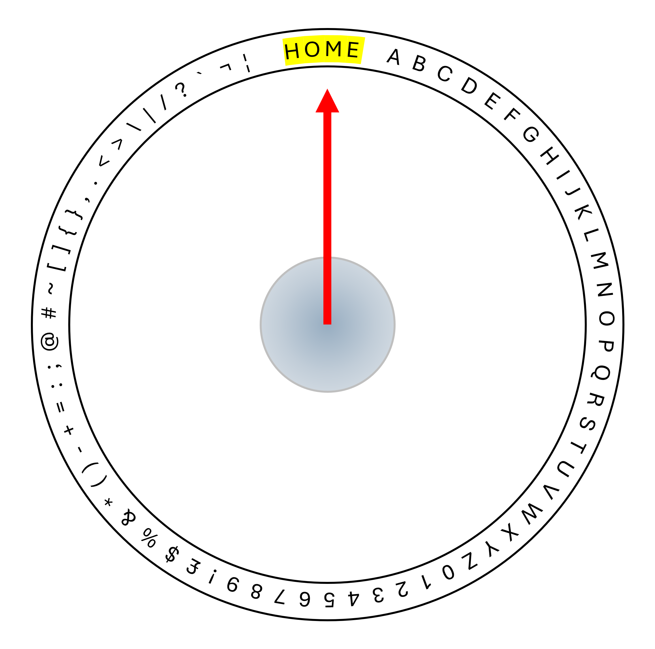
The Virtual Disc — Orientation Encoding
HOME / REST = 0°
Permanently reserved. Never assigned to any character. Serves as start and end-of-message delimiter.
A = first position
Character A is assigned immediately after the HOME zone. All characters distributed evenly around the remaining arc.
Orientation → Character
Each unique angle maps to one character via a software lookup table — the 'virtual disc'. Identical table loaded on both units at manufacture.
Dual-ring upgrade
Adding a perpendicular vertical ring gives two independent axes. At 10° resolution: 36 × 36 = 1,296 unique states — full alphanumeric + extended characters.
Quantum Entangled Multiplexing Transceiver (QEMT) | Daniel Miles · 2026

Slide 4
Row Structure — All Particles Share One Orientation
H (10°)
Ensemble averaging
The receiver weak-measures all 10 particles and averages. Noise reduces by √10 ≈ 3.2×.
E (50°)
All 10 are data particles
L (120°)
No particle is reserved — all 10 per row carry orientation data.
← All 10 particles per row: identical orientation
SNR scales with N
100 particles per row → 10× noise reduction.
10,000 particles → 100× noise reduction.
Quantum Entangled Multiplexing Transceiver (QEMT) | Daniel Miles · 2026

Slide 5
Transceiver Architecture
Machine A
Machine B
MCU + Coil Array
A-TX → B-RX
MCU + Coil Array
TX ROWS
TX rows of A entangled with
RX rows of B
TX ROWS
orient → transmit
(same orientation per row)
orient → transmit
(same orientation per row)
B-TX → A-RX
TX rows of B entangled with
RX rows of A
TX / RX split
TX / RX split
RX ROWS
RX ROWS
weak-read → decode
(average N reads per row)
weak-read → decode
(average N reads per row)
Full-duplex: simultaneous TX and RX on a single slab
Quantum Entangled Multiplexing Transceiver (QEMT) | Daniel Miles · 2026

Slide 6
Reading Mechanism — Weak Measurement
Particle
(spin state)
Ensemble N | Angular Res. | Chars (10°) | SNR Gain
1 | ±45° | 4 | baseline
10 | ±14° | 12 | +10 dB
100 | ±4.5° | 32 | +20 dB
1,000 | ±1.4° | 64+ | +30 dB
10,000 | ±0.45° | Full set | +40 dB
Probe Laser
(low-power)
Photodetector
+ ADC
MCU
(averages N reads)
Formula: Angular resolution = ±45° ÷ √N
Weak measurement: partial state interrogation — does not fully collapse the quantum state.
Each read extracts a small amount of orientation information. N reads converge to the true angle.
Virtual Disc
(lookup → character)
Quantum Entangled Multiplexing Transceiver (QEMT) | Daniel Miles · 2026

Slide 7
Writing Mechanism — Setting Particle Orientation
Method 1
Method 2
Method 3
ESR / Microwave Pulse
Optical Pumping
Miniature Coil ★ Recommended
› Microwave pulse at Larmor frequency
› Resonant laser pulse sets spin state
› Per-cavity nanoscale coil
› Pulse duration sets rotation angle
› Beam polarisation defines axis
› MCU GPIO drives current pulse
› Rabi oscillation → any angle achievable
› Nanosecond timescale
› No optical alignment needed
› Precision: < 0.1° achievable
› Precision: ~1° per pulse
› Row × column matrix addressing
Standard NMR/ESR technique
Used in NV centre quantum gates
Fabricated in same e-beam step as cavity grid
Quantum Entangled Multiplexing Transceiver (QEMT) | Daniel Miles · 2026

Slide 8
Miniature Coil — Per-Cavity Magnetic Write
Each photon cavity in the slab is surrounded by a nanoscale coil fabricated in the same electron-beam lithography step as the cavity grid.
Coil diameter | 50 – 200 nm (scales with cavity)
Wire material | Superconducting NbTi or normal Cu
Field strength | 1 – 100 mT (sufficient for Larmor rotation)
Pulse duration | 1 – 100 ns (Rabi pi-pulse to set angle)
Addressing | Row select × column select via MCU GPIO
Fabrication | E-beam lithography — same step as cavity grid
Precision | Sub-degree angular control achievable
Advantage | No laser alignment — pure electrical control
CAVITY CROSS-SECTION
NV
qubit
MCU
B-field →
SiC / YSO substrate
Quantum Entangled Multiplexing Transceiver (QEMT) | Daniel Miles · 2026

Slide 9
Slab Operating Modes
Mode 1
Full Transmission
Mode 2
Half-Duplex Split
Mode 3
Dynamic Allocation
TX
TX
TX
TX
TX
TX
TX
TX
TX
TX
TX
TX
TX
RX
TX
TX
RX
TX
TX
RX
RX
TX
RX
RX
All rows transmit the same character simultaneously. Maximum ensemble size — all N×rows particles average together. Highest SNR. Use when channel quality is poor.
Top half TX, bottom half RX simultaneously. Enables real-time bidirectional data transfer. Each direction uses N×(rows/2) particles.
MCU adjusts TX:RX row ratio in software per demand. Match asymmetric bandwidth (e.g. 80% TX when sending files, 20% TX when listening). Adaptive streaming.
Quantum Entangled Multiplexing Transceiver (QEMT) | Daniel Miles · 2026

Slide 10
Transmission Modes — How Messages Are Sent
A
Maximum Signal
B
Parallel Message
C
Cascading Pipeline
All rows → same character
Each row → different character
Rolling row advance
All TX rows set to the same orientation simultaneously. If the slab has 100 rows × 10 particles, the receiver averages 1,000 readings for a single character.
Use when: channel quality is poor, maximum SNR needed, or confirming the channel is working.
Each TX row set to a different orientation. A 50-row slab transmits 50 characters simultaneously. After dwell window, next 50 characters load instantly.
Use when: high throughput is the priority. Throughput = rows × chars per dwell.
Rows act as a shift register. When row 1 completes its dwell, it advances to character N+1 while row 2 still holds character N. Creates a continuous pipeline.
Use when: streaming data with minimum latency. No dead time between characters.
Quantum Entangled Multiplexing Transceiver (QEMT) | Daniel Miles · 2026

Slide 11
Manufacturing Process
1
Substrate Prep
2
Entanglement Source
3
Pair Loading
SiC wafer or rare-earth doped crystal grown and polished. Grid nodes defined by electron-beam lithography.
UV laser pumps SPDC crystal generating entangled photon pairs. Fibres route each to matching grid nodes.
Each photon captured at position [x,y] on each half. Herald photon confirms capture per position.
4
Cleavage
5
Encapsulation
6
Deployment
Single wafer cleaved along central plane — like splitting a book. Slab A and B result. Correspondence guaranteed by geometry.
Each slab sealed in vacuum or cryo housing. RF coils, laser array, photodetector, and MCU board attached.
Slab B shipped to remote site. No calibration required — correspondence is guaranteed by the cleavage geometry.
Key insight: cleavage manufacturing guarantees position [x,y] on Slab A is entangled with [x,y] on Slab B — no lookup table or calibration needed.
Quantum Entangled Multiplexing Transceiver (QEMT) | Daniel Miles · 2026

Slide 12
Chip-Scale Integration — QEMT-1
Peltier Cooling Layer
› No FPGA required — single MCU handles all logic
Power / GND
Microcontroller (disc lookup · framing · averaging · GPIO)
› Peltier cooler replaces bulky cryo systems
› RF coils eliminate optical alignment requirement
Photodetector Array (RX weak-read + ADC)
Classical I/O
› Standard chip package — solderable, portable
Entangled Slab (NV centre / SiC)
Fibre optic port
RF Coil Array + Probe Laser (TX write / RX read)
Re-entangle port
QEMT-1 Chip Package (target: 12mm × 8mm)
Quantum Entangled Multiplexing Transceiver (QEMT) | Daniel Miles · 2026

Slide 13
Viable Substrate Materials — Ranked by FTL Fitness
Coherence time is the dominant factor. Short coherence = Poor FTL fitness regardless of other advantages. Practical QEMT needs hours to days of coherence minimum.
Material | Coherence | Temp | Scalability | FTL Fitness
Rare Earth YSO (Eu/Pr) | HOURS ★★★★★ | 4 K | Moderate | EXCELLENT #1
NV Centres in Diamond | ms – s ★★★★ | Room temp | Limited | GOOD #2
Phosphorus in Si (Si:P) | s (nuclear) ★★★★ | Room temp* | Excellent | GOOD #3
Silicon Carbide (SiC) | us – ms ★★ | Room temp | Excellent | MARGINAL
Trapped Ions (Ca+) | s – min ★★★ | Near 0 K | Very Poor | MARGINAL (lab only)
Photonic Crystal (Si) | ps – ns ★ | Room temp | Excellent | POOR — coherence fatal
Superconducting Qubits | us – ms ★★ | 15 mK | Good | POOR — coherence + cryo
Quantum Dots (InAs) | ns – us ★ | 4 K | Good | POOR — coherence short
* Si:P nuclear spin coherence at room temp. Electron spin requires cooling. ★ = coherence quality for QEMT use.
Quantum Entangled Multiplexing Transceiver (QEMT) | Daniel Miles · 2026

Slide 14
The Open
Experimental Question
What the theorem says
The no-communication theorem is proven within current QM formalism for discrete single-shot measurements.
What QEMT does differently
Spatially parallel · continuous-variable orientation encoding · large-ensemble weak-measurement · global phase reference shared at manufacture. This regime is not fully addressed by existing proofs.
The experimental question
At what ensemble size N, if any, does the averaged orientation signal on the RX slab exceed the uncertainty-principle noise floor?
Either result matters
If N = never: theorem confirmed in new regime — publishable. If above some N: physics must be revised — historic.
Independent value
The QEMT apparatus is a world-class quantum sensor regardless of the FTL outcome. Atomic clocks · gravitational wave detection · QKD hardware.
Quantum Entangled Multiplexing Transceiver (QEMT) | Daniel Miles · 2026

